Slide 1

MINI PROJECT Project Name - EDA and Statistical Analysis Of Mod Clothing Dataset
Presented By - Subham Pratik Khuntia
Shachi Vaidya
Rupal Sanjay Nikum
Prakhar Purohit
Jitendra Dixit

Slide 2
PART – A
The following data represents the price in dollars for branded shirts in a website NuCloth.
23 30 20 27 44 26 35 20 29 29
25 15 18 27 19 22 12 26 34 15
27 35 26 43 35 14 24 12 23 31
40 35 38 57 22 42 24 21 27 33

Slide 3
Import the required libraries
# import pandas
import pandas as pd
# import numpy
import numpy as np
# import matplotlib.pyplot
import matplotlib.pyplot as plt
# import seaborn
import seaborn as sns
# to suppress the warnings
import warnings
warnings.filterwarnings('ignore’)
import plotly
import plotly.graph_objects as go
import plotly.express as px
import json
# import statistics to perform statistical computations
import statistics
# import 'stats' package from scipy library
from scipy import stats
# import statistics to perform statistical computations
import statistics
# to test the normality
from scipy.stats import Shapiro
# import a library to perform Z-test
from statsmodels.stats import weightstats
# import statsmodels
import statsmodels.api as sm
from statsmodels.formula.api import ols
from statsmodels.stats.anova import anova_lm
# import the functions to perform Chi-square tests
from scipy.stats import chi2_contingency
from scipy.stats import chi2
from scipy.stats import chisquare
# function to perform post-hoc test
import statsmodels.stats.multicomp as mc
# import function to perform post-hoc
# install scikit_posthocs using "!pip install scikit_posthocs"
import scikit_posthocs

Slide 4
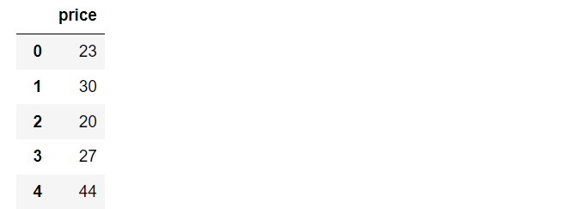
Create DataFrame
Code – dat = pd.DataFrame({'price' :[23, 30 ,20 ,27, 44 ,26 ,35 ,20 ,29 ,29,
25, 15, 18 ,27 ,19 ,22 ,12, 26, 34 ,15,
27, 35, 26 ,43, 35 ,14 ,24, 12 ,23, 31,
40, 35, 38, 57, 22 ,42 ,24, 21, 27 ,33]})
dat.head()
Output –

Slide 5

Project Flow
Q1. Compute the mean, median and the mode of the data
Code – dat.mean()
dat.median()
dat.mode()
Solution - To get central tendency of data that is mean , median and mode we used .mean(), median(), mode() functions.
Inference – The output is showing mean , median and mode of the price.
Output -

Slide 6
Project Flow
Q2. Compute the range , variance and standard deviation of the data.
Code - Range=dat.max()-dat.min()
Range
dat.var()
dat.std()
Solution – To get the range that is difference between maximum value and minimum value we have used max() and min() function.were var() and std() is used to get the variance and standard deviation.
Inference – In output we get the price range that is difference between maximum price and minimum price. Also the variance and standard deviation of price variable has been retrived.
Output- 45
92.59935897435898
9.622856071580774

Slide 7

Project Flow
Q3. Find the mean deviation for the data . The mean deviation is defined as below.
Code - mad =dat.mad(axis=0)
mad
Solution -To get the mean absolute Deviation for series we have used mad() function for index axis.
Inference - We get the Mean Absolute deviation of prices.
Output – 7.4

Slide 8
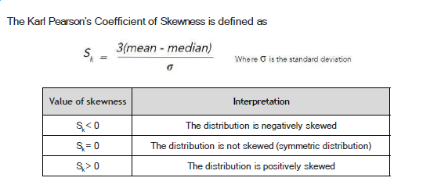
Project Flow
Q4. Calculate the Pearson coefficient of skewness and comment on the skewness of the data.
Code – dat_mean=dat.mean()
dat_med=dat.median()
dat_std=dat.std()
s_kp=(3*(dat_mean-dat_med))/dat_std
print(s_kp)
Solution – Firstly we have find mean , median and standard Deviation and then find the pearson’s coefficient of skewness that is
Inference –Skewness tells us the direction of outliers. While all other variable are Positively skewd.
Output – 0.3507274737245009

Slide 9
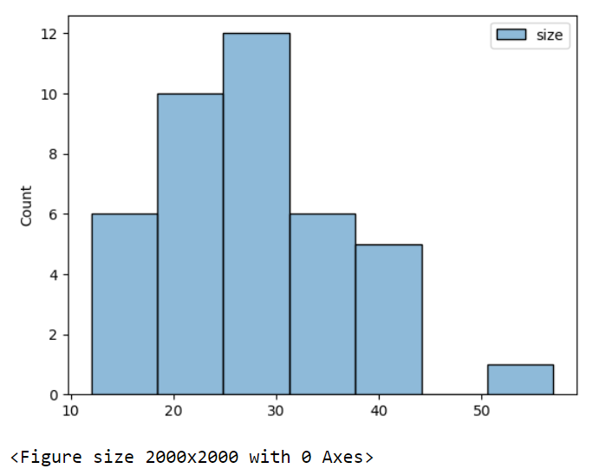
Code – df_num= NuCloth.select_dtypes(include=np.number)
sns.histplot(df_num)
plt.figure(figsize=(20,20))
plt.show()
Inference – The output shows that the data is is positively Right Skewed.
Output –

Slide 10
Project Flow
Q5. Count the number of data values that fall within two standard deviations of the mean. Compare this with the answer from Chebyshev’s Theorem.
Code – mean=dat.mean()
std=dat.std()
mean+2*std
quan=dat.quantile(0.95)
quan
Solution – Here we firstly calculated mean and standard deviation of Data and by using Chebyshev’s Theorem we found the minimum proportion of observation that fall within the specified number of standard deviation from mean. Later we compare with the another approach were we used .quantile() function.
Inference – Both answer are close to each other
Output –

Slide 11
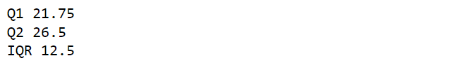
Project Flow
Q6. Find the three quartiles and the interquartile range (IQR).
Code – Q1=dat.quantile(0.25)
Q2=dat.quantile(0.50)
Q3=dat.quantile(0.75)
IQR=Q3-Q1
print("Q1",Q1)
print("Q2",Q2)
print("IQR",IQR)
Solution – Here we have firstly find all the three quartiles by using Quantile() function and then find Inter Quartile Range by using a formula that is Q3-Q1
Inference – The output shows that 12.5 Per areas lie in Inter Quartile range
Output –

Slide 12
Project Flow
Q7. Are there any outliers in the data set ?
output – Yes
Solution – By referring the output of question number 8
Inference – By referring the output of Q8 we can conclude that , yes there is one outlier present in data.

Slide 13
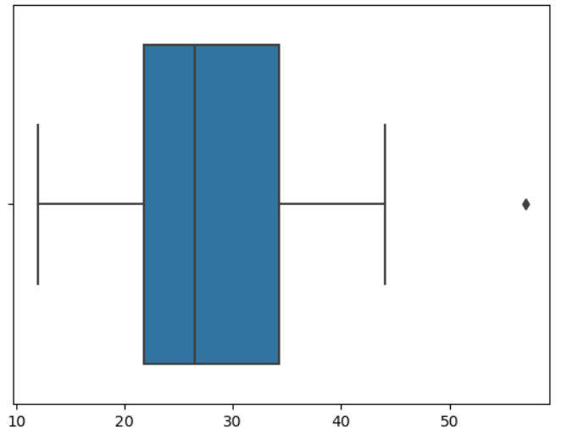
Project Flow
Q8. Draw a boxplot of the dataset to confirm .
Code – sns.boxplot(dat)
plt.show()
Solution – Box Plot has been used to show the outliers present in data. It gives idea about the variance od data and presence of outliers. The whiskers represent the spread of data.
Inference – The dots outsides of the whiskers show outlier values.There is only one outlier.
Output –

Slide 14
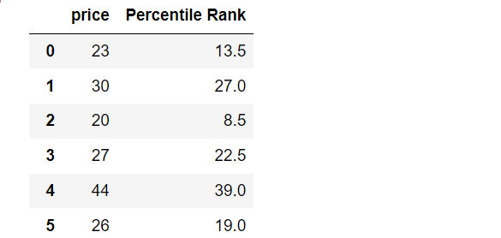
Project Flow
Q9. Find the percentile rank of the datapoint 25.
Code – dat['Percentile Rank'] = dat[‘Price'].rank(pct=True)
dat.head()
Solution – By using .rank() function is used to get the rank of each prices and pct=True will convert the rank into the percentile rank .
Inference – The output is showing percentile rank foe each prices.
Output –

Slide 15

Project Flow
Q10. What is the probability that a shirt cost is above 25 dollars?
Code – num=len(dat[dat[‘price']>25])
den=len(dat[‘price’])
prob=num/den
print("The probability that a shirt cost is above 25 dollars :“, prob)
Solution – Firstly we found the len of prices whose cost is greater then 25 dollars and the to get the proportion we divided it by the total length of sample.
Inference – We get the probability of shirt cost is above 25 dollars.
Output –

Slide 16
Project Flow
Q11. Create a frequency distribution for the data and visualize it appropriately
Code – df=dat.value_counts()
df.plot(kind='bar’)
plt.show()
Solution- we have find the value count of data which is frequency of prices then we used bar plot to show frequency distribution of prices.
Inference – We get output which is representing the frequency distribution of prices.The product with price 27 dollar and 35 dollar are having high frequency that is 4.

Slide 17
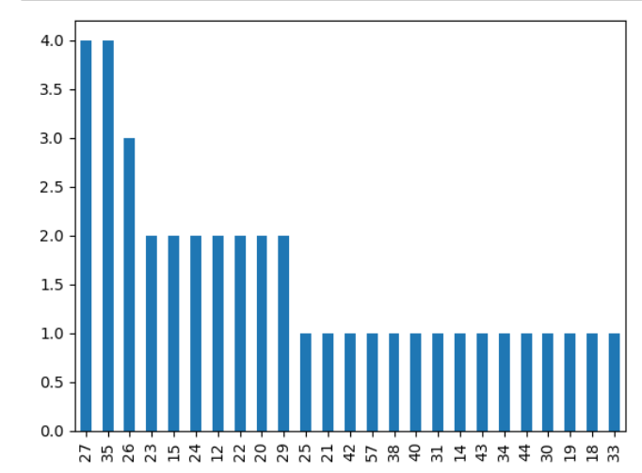
Output –

Slide 18
Project Flow
Q12. Create a probability distribution of the data and visualize it appropriately
Code – mu = np.mean(dat.price)
sig = dat.size.std()
dat['prob'] = 0.0
for idx,row in dat.iterrows():
if row.size < mu:
dat.at[idx,'prob'] = 1 - (stats.norm(mu,sig).pdf(row.size))
else:
dat.at[idx,'prob'] = stats.norm(mu, sig).pdf(row.size)
sns.distplot(dat['prob'])

Slide 19
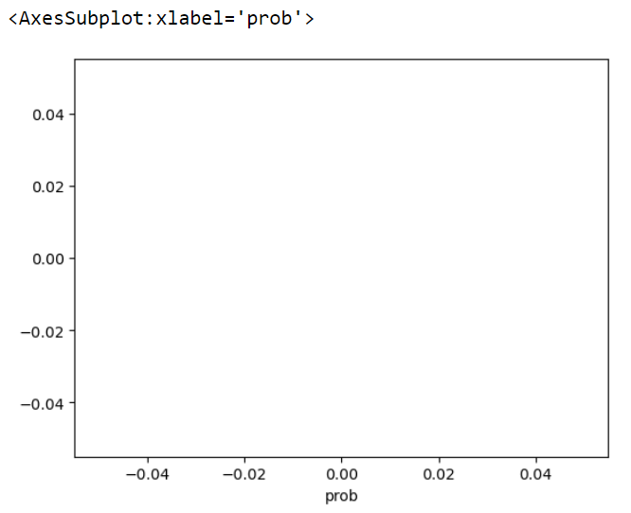
Output –

Slide 20
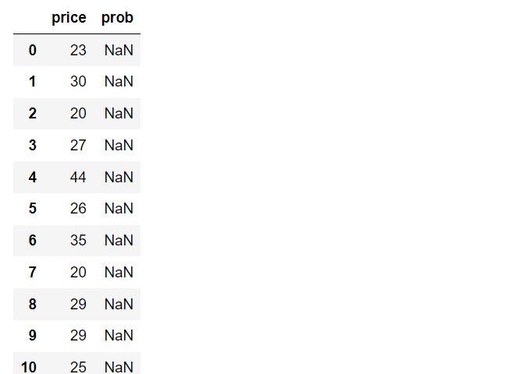
Code – NuCloth
Output –

Slide 21
Project Flow
Q13. What is the shape of the distribution of this dataset? Create an appropriate graph to determine that. Take 100 random samples with replacement from this dataset of size 5 each. Create a sampling distribution of the mean shirt prices. Compare with other sampling distributions of sample size 10, 15, 20, 25, 30. State your observations. Does it corroborate the Central Limit Theorem?
Code – sns.histplot(NuCloth[‘Price’])
plt.show()
Solution – Firstly we have shown the frequency distribution of price through histogram.
Inference – A distribution is said to be positively skewed when the tail on the right side of the histogram is longer than the left side. Most of the values tend to cluster toward the left side of the x-axis (i.e. the smaller values) with increasingly fewer values at the right side of the x-axis (i.e. the larger values).

Slide 22
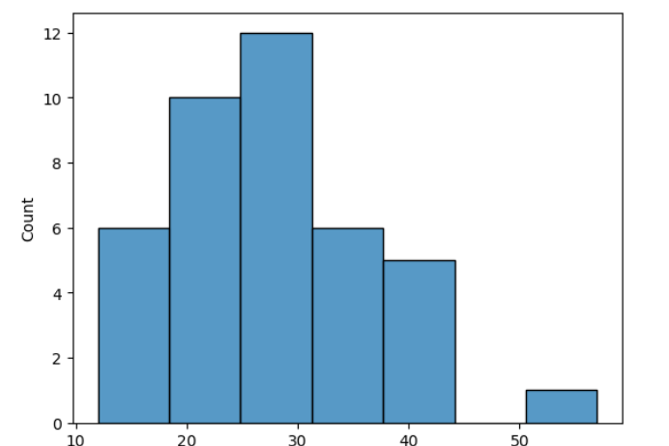
Output –

Slide 23
Code – sample_size=5
n_samples=100
population_array=dat[‘Price']
# create an empty list to store the means of each sample
sample_means = []
for i in range(n_samples):
# generates a random sample of size 100 from the population array
sample = np.random.choice(population_array, size=sample_size, replace=True)
sample_mean = np.mean(sample) # calculate the mean of the sample data
sample_means.append(sample_mean) # append the mean to the list
print(sample_means)
sns.distplot(sample_means)
plt.title("Sampling Distribution", fontsize=15)
plt.show()
Solution – In this we have calculated the mean of sample by taking random samples from array and then show a sample distribution through density plot.
Inference – The output we got showing the list of sample mean and the graph represent the sampling distribution .The data is normally distributed.

Slide 24
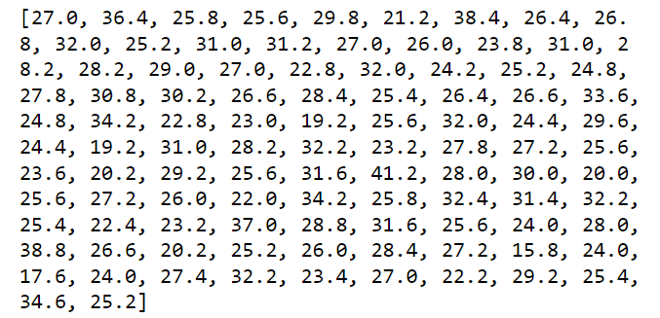
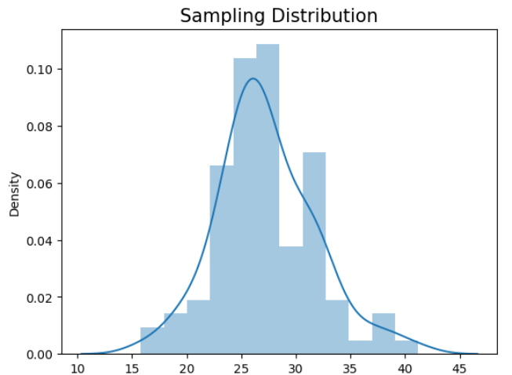
Output –

Slide 25

Project Flow
Q14. Treat this dataset as a binomial distribution where p is the probability that a shirt costs above 25 dollars. What is the probability that out of a random sample of 10 shirts 7 are costing more than 25 dollars?
Code – data= dat[dat[‘Price']>25]
data=len(data)/len(dat)
p=data
n=10
x=7
prob=stats.binom.pmf(x,n,p)
print('The probability that out of a random sample of 10 shirts 7 are costing more than 25 dollars is :',prob)
Solution – Firstly we have filtered the data which having price greater then 25 dollar,and then through binomial distribution we get the probability for cost greater then 25.
Inference – We got the output that showing that the probability of that out of random sample of 10 shirts where 7 are costing more than 25 dollars.
Output –

Slide 26

Project Flow
Q15. NuCloth Claims that 60% of all shirts in their website cost less than 25 dollars . Using the Normal approximation of a Binomial distribution, find the probability that in a random sample of 10 shirts 7 of them will cost less than 25 dollars. [ Note that the normal distribution can be used to approximate a binomial distribution if np>=5 and nq>=5 with the following correction for continuity P(X=z) = P(z-0.5 < X < z+0.5 ) ]
Code – p=0.6
n=10
x=7
prob= stats.binom.cdf(7,10,0.60)
print('find the probability that in a random sample of 10 shirts 7 of them will cost less than 25 dollars is:',prob)
Solution – Here to find the probability of 60% of all shirts whose cost is less then 25 dollars we used binomial distribution. By taking proportion 60 % ,sample size 10 and number of sample 7.
Inference – We got the output that showing that the probability of that out of random sample of 10 shirts where 7 are costing less than 25 dollars.
Output –

Slide 27

Project Flow
Q16. Compute a 95% Confidence Interval for the true price of a shirt in the NuCloth website using appropriate distribution.( State reasons as to why did you use a z or t distribution)
Code – x_bar=np.mean(dat[‘Price’])
n=len(dat[‘Price’])
sig=np.std(dat[‘Price'],ddof=1)
alpha=0.05
z_alpha_by_2 = stats.norm.isf(0.05/2)
print(z_alpha_by_2)
upper = x_bar + z_alpha_by_2 * sig / np.sqrt(n)
lower = x_bar - z_alpha_by_2 * sig / np.sqrt(n)
print('95% Confidence interval for true price of shirt is:', lower, upper)
Solution – To get 95% confidence interval firstly we find Z critical and then by manual calculation we find the confidence interval for both upper and lower sample statistic.
Inference – The output we got shows the z critical value and confidence interval for 95%.
Output –

Slide 28
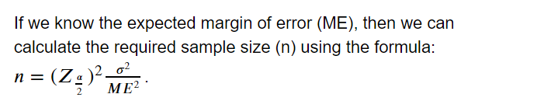
Project Flow
Q17. A data scientist wants to estimate with 95% confidence the true proportion of shirts having price greater than 25 dollars in the NuCloth website. A recent study showed that 60% of all shirts have a price greater than 25 dollars. The data scientist wants to be accurate within 2% of the true proportion. Find the minimum sample size necessary.
Code – sigma =0.60
margin_of_error = 0.02
alpha = 0.05
z_alpha_by_2 = stats.norm.isf(0.05/2)
# calculate sample size (n)
n =(z_alpha_by_2*sigma/margin_of_error )**2
print('Required Sample Size:', round(n))
Solution – To get samle size we done manual calculation by taking standard deviation ,margin of error and z critical .we used the following formula .
Output –

Slide 29
Project Flow
Q18. The same data scientist wants to estimate the true proportion of shirts having price greater than 25 dollars. She wants to be 90% confident and accurate within 5% of true proportion. Find the minimum sample size necessary.
Code – df_1=dat.drop(['Percentile Rank'], axis=1)
df_1.head()
df_2=df_1[(df_1['size'])>25]
df_2
sigma =0.6
margin_of_error = 0.05
alpha = 0.1
z_alpha_2 = stats.norm.isf(0.1/2)
z_alpha_2
# calculate sample size (n)
n=(z_alpha_2 * sigma/margin_of_error)**2
n
Solution – Firstly we have droped the percentile rank column and filtered the prices greater than 25 dollar and by diven margin of error we calculated sample size.
Inference – The minimum sample size for shirt having price greater then 25 dollar is:
Output – 389.5982573897397

Slide 30
Project Flow
Q19. NuCloth claims that currently 80% of all shirts have prices greater than 25 dollars . Test this claim with an alpha =0.05 if out of a random sample of 30 shirts only 23 are having prices above 25 dollars.
Code – #H0:mu=80
#H1:mu<0.80
hypo_p=0.8
x=23
n=30
p_samp=x/n
z_stat=(p_samp-hypo_p)/np.sqrt((hypo_p*(1-hypo_p))/n)
p_val=stats.norm.sf(z_stat)
print('Test stat',z_stat)
print(p_val)
Solution – To test the assumption wheather it is true or not we used Z test hypothesis method ,where we calculated the z statistic and p value.
Inference – As p_value >alpha(0.05) we fail to reject null hypothesis ,hence 80% of shirts have prices greater than 25.
As Zstat is > z_critical so we reject H0
Output –

Slide 31
Project Flow
Q20. A data scientist is researching the hypothesis that the average price of a shirt in NuCloth is higher than the supermarket. So he collects data from NuCloth and the supermarket that the average shirt price of shirts in NuCloth is 36 dollars vs 34 dollars in the supermarket. The standard deviations are 7.6 and 5.8 respectively.Suppose the data scientist got these values after randomly selecting 100 shirts from each place.
a. What hypothesis would he use to compare the shirt prices of NuCloth vs Supermarket
Code – x1_bar=36
x2_bar=34
s1=7.6
s2=5.8
n1=100
n2=100
null_value=0
denominator = np.sqrt((s1**2 / n1) + (s2**2 / n2))
zscore = ((x1_bar - x2_bar) - (null_value)) / denominator
print('z-score:', zscore)

Slide 32
Solution – The hypothesis we used to compare prices of NuCloth vs Supermarket was - H0:mu_of_NuCloth-mu_of_supermarket<=0
H1:mu_of_NuCloth-mu_of_supermarket>0
And then find Z score value .
Inference – The output showing Z statistic value
Output – Z-Score: 2.09197696327652

Slide 33
Project Flow
b. What are critical values to be used?
Code – z_critical = round(stats.norm.isf(0.05/2), 2)
z_critical
Solution – We find critical value by Z critical
Inference – The critical value was found to be:
Output – 1.96

Slide 34
Project Flow
c. What statistical test will be used to compare these prices?
Solution – To compare the prices we used Z Statistical test
d. Complete the test and obtain the P-value.
Code – p_val=stats.norm.sf(zscore)
p_val
Output – 0.018220288245112185
e. Summarize his conclusion based on the P-value.
Inference – As p_val < alpha(0.05) Hence we reject null Hypothesis so the claim of Data scientist that average price of Nucloth Shirt is more than Supermarket is correct.

Slide 35
PART – B
Dataset Description –
This dataset contains self-reported clothing-fit feedback from customers as well as other side information like reviews, ratings, product categories, catalog sizes, customers’ measurements (etc.) from 2 websites:
Mod Cloth
2. Rent the runway
1. Mod Cloth sells women’s vintage clothing and accessories, from which the curator of the dataset collected data from three categories: dresses, tops, and bottoms.
2. Rent The Run Way is a unique platform that allows women to rent clothes for various occasions; they collected data from several categories.

Slide 36
Problem Statement:
Let’s assume you are working as a data scientist in a newly started textile company. You have given a dataset that consists of most of the features related to the measurements, clothes types, Product ID, User ID, etc. Now you suppose to work the dataset to identify the patterns to understand the customer’s preferred brands and how the company needs to brand its products based on the patterns that you will be found them out. Explore all the EDA concepts you learned and use a statistical test to ensure that your identification is true or false.

Slide 37
Project Flow
1.Read the datasets, Check the data types and Change the data types appropriately.
Code – js=pd.read_json('modcloth_final_data.json',lines=True)
js.head()
js.dtypes
Solution – Python can read a files from different sources. The file type was Json hence, we used .read_json() function .And to check data types we used .dtyes() function.
Inference – All the data types was correct hence there was no need to change the data type.

Slide 38
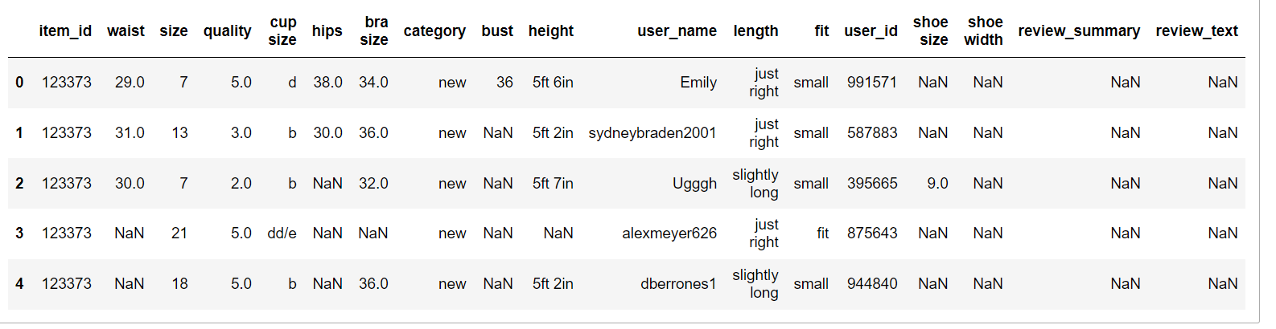
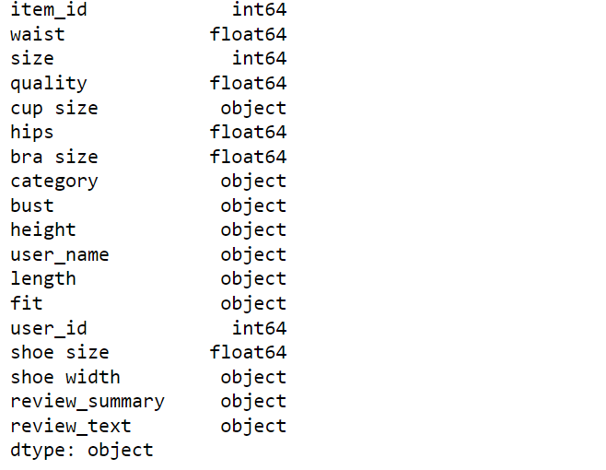
Output –

Slide 39
Project Flow
2.Change the height column datatype to float after converting the values as shown
Code – js['height'] = js['height'].str.replace('\D+','.’)
js['height'] = js['height'].str.rstrip('.’)
js.head()
js[['height']] = js[['height']].astype(float)
js[['quality']] = js[['quality']].astype(float)
js.info()
Solution – In this we firstly replaced the ‘ ft ‘ by ‘ . ‘ then by using rstrip() method we removed the trailing character from height variable . Later then we change the data type of height and quality by using astype() function.
Inference – The ouput showing changed data type of variables height from object to float.

Slide 40
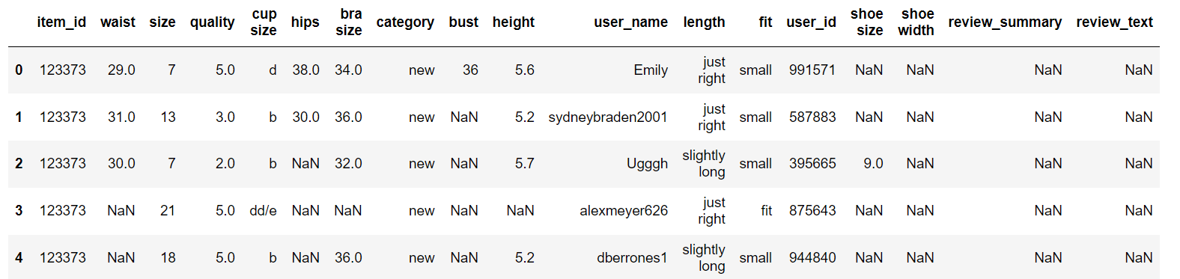
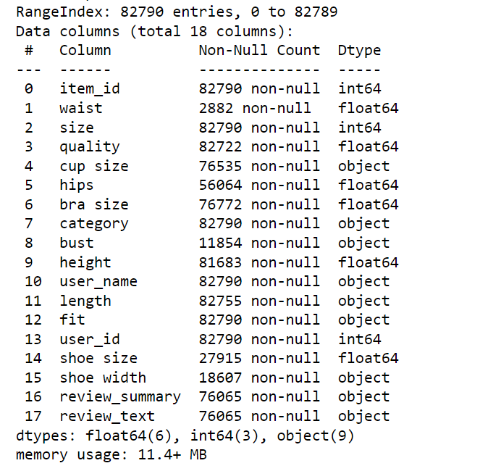
Output –

Slide 41
Project Flow
3.Rename the names of the columns which have space in between the column. Ex: shoe size as shoe_size etc.
Code – js=js.rename(columns = {'cup size':'cup_size','bra size':'bra_size','shoe size':'shoe_size','shoe width':'shoe_width'})
js.head()
Solution – In this we used .rename() function in that we created the dictionary of prevision column name as key and updated columns name as values.
Inference – The output shows updated variable names.

Slide 42
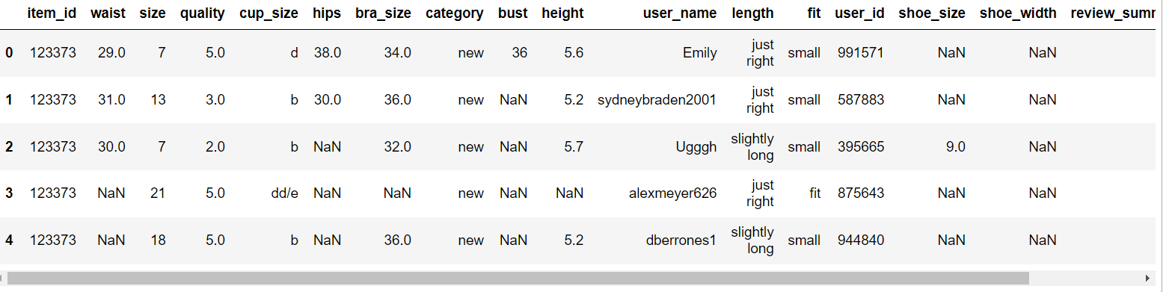
Output –

Slide 43
Project Flow
4. Check the missing values and Identify the distribution of the variables to impute the missing values. Explain based on your analysis decide the features which can be dropped and Which can be imputed. And also explain the reason to choose the metric that you have chosen to impute the null values. Note: Kindly copy the datasets and work on the new data frame.
4.1 Check the count and percentage of missing values.
Code – missing_values=js.isnull().sum()[js.isnull().sum()>0]
missing_values
missing_values/len(js)*100
Solution – Here we found count of null values in each variable and later we also found the percentage of missing values in each variables.
Inference – The first output representing the total count of null values in each variable , and second output is showing percentage of missing values in each variables.

Slide 44
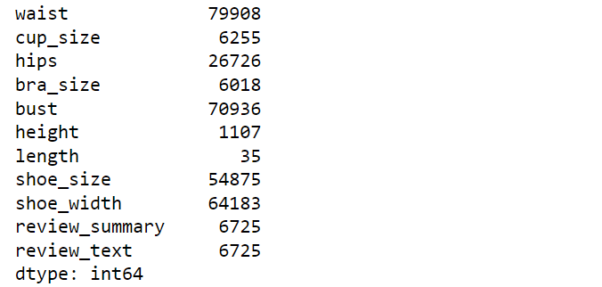
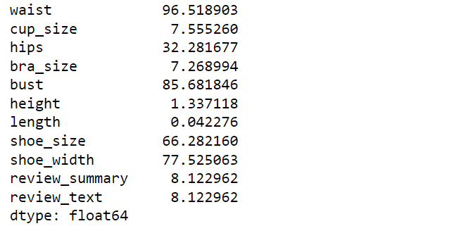
Output –

Slide 45
Project Flow
4.2 check the Mean and Median.
Code – print('MEAN:',js.mean())
print('MEDIAN:',js.median())
Solution – To check central tendency that is mean median of variables we used .mean() and .median() functions.
Inference – The output representing the mean and median for each variables in dataset.

Slide 46
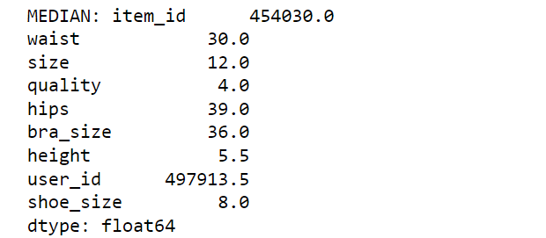
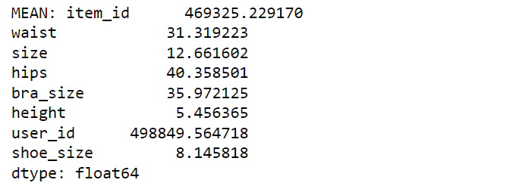
Output –

Slide 47
Project Flow
4.3 Check the distribution of the variables using Histogram or Dist plot or KDE and boxplot etc. Kindly explore at least two.
Code – plt.figure(figsize=(15,7))
js.hist()
plt.xlabel(' ',fontsize=18)
plt.ylabel(' ',fontsize=18)
plt.show()
plt.figure(figsize=(10,7))
sns.boxplot('height',data=js)
plt.xlabel('height', fontsize=18)
plt.show()
Solution – To show distribution of variables we used histogram and box plot .Histogram represent the frequency distribution of each variable. And through box plot we can identify the outliers.
Inference – The output representing the frequency distribution for each variable and through box plot we identified the outliers present in Height column . There are extream outliers are present in height column.

Slide 48
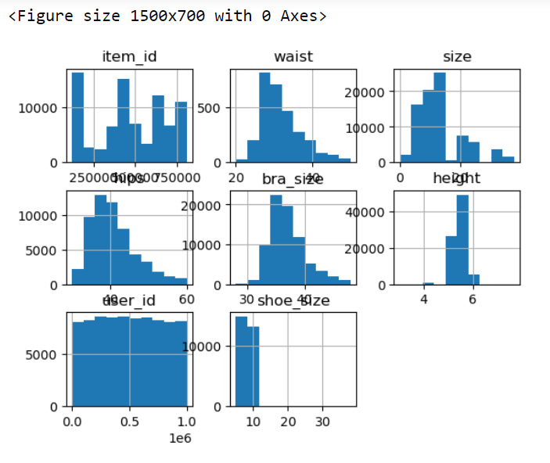
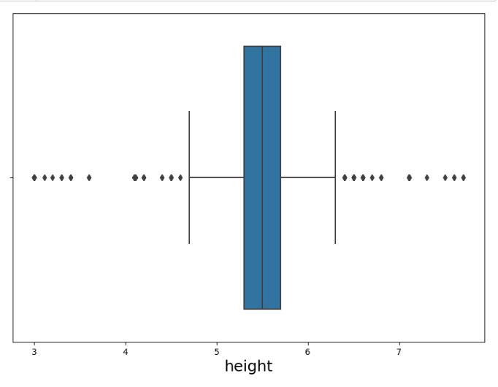
Output –

Slide 49
Project Flow
4.4 Check the Skewness and Kurtosis. Explain what the Skewness and Kurtosis describe.
Code – js.skew()
js.kurt()
Solution – To get the skewness of data we used .skew() function and the to Measures the peakedness of the distribution we used .kurt() function.
Inference – The output showing that some of the variables are near symmetric as they have positive and near 0 skewness, while some are negatively skewed . In another output some of the variables like (height , shoe_size) having the distribution is leptokurtic because the the value is greater then 3 while some are platykurtic because the value is less then 3.

Slide 50
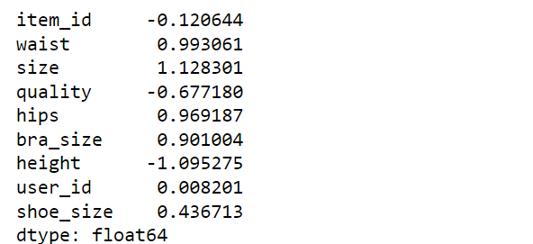
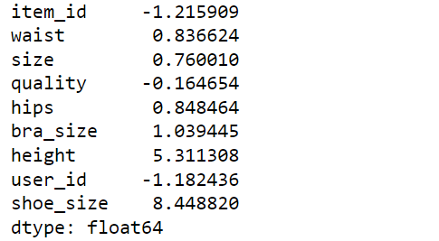
Output –

Slide 51
Project Flow
4.5 Based on the above approach impute the missing values with the right metric. Or If you want to get some analysis before imputing missing values feel free to explore the analysis.
Code – js['cup_size'].value_counts()
js['cup_size'].replace(np.nan,'c',inplace=True)
Solution – We have find the value count of each category in cup_size variable and then we replace the null value with ‘c’.
Inference – As 'cup_size' is a categorical variable we replace the Nan_values by frequency.

Slide 52
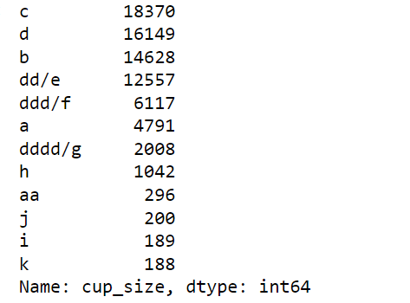
Output –
To Be Continued …..

Slide 53
Code –
plt.figure(figsize=(10,7))
plt.xlabel('hips', fontsize=18)
sns.boxplot('hips',data=js)
plt.show()
med_hips=js['hips'].astype('float').median()
js['hips'].replace(np.nan,med_hips,inplace=True)
Solution – Here we plot box plot for variable ‘hips’ to check the presence of outliers and then changed the data type of variable into float and replaced the null value with median.
Inference – The output shows the presence of outliers in column hence we replace the null values by median as the outliers are present.

Slide 54
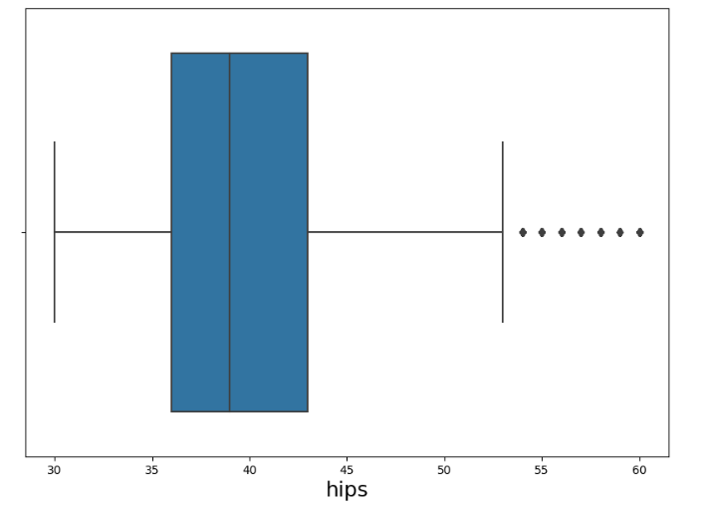
Output –
To be continued……..

Slide 55
Code – plt.figure(figsize=(10,7))
plt.xlabel('bra_size', fontsize=18)
sns.boxplot('bra_size',data=js)
plt.show()
med_br=js['bra_size'].astype('float').median()
js['bra_size'].replace(np.nan,med_br,inplace=True)
Solution – Firstly we plot the box plot for variable ‘bra_size’ to check the presence of outliers
And then we replaced the null value with median.
Inference – The output shows there are two outliers present in given columns and as the column contain outlier we have replaced the null value with median because median does not get affected by presence of extrem values.

Slide 56
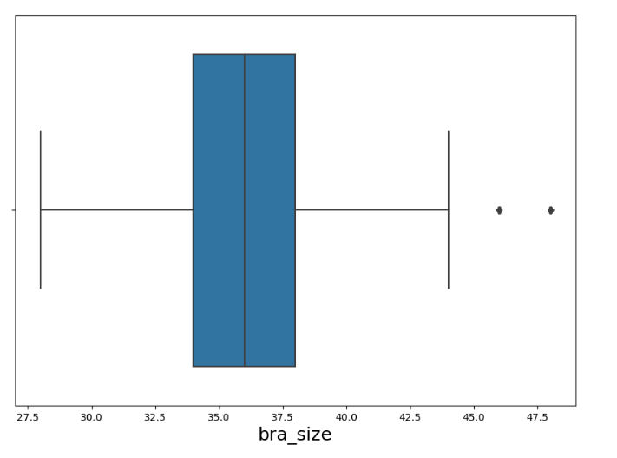
Output –
To be continued……..

Slide 57
Code – js['review_summary'].value_counts()
js['review_summary'].replace(np.nan,'Love it!',inplace=True)
js['review_text'].value_counts()
js['review_text'].replace(np.nan,'Love it!',inplace=True)
figure=plt.figure(figsize=(8,5))
sns.heatmap(js.isnull(),cbar= False)
plt.show()
Solution – Replacing by frequency as height,review_summary , review_text is categorical variable . We can also drop the columns which are not necessary by using drop() function.
Inference – No missing values present as the columns that are not required for analysis are dropped or replaced.

Slide 58
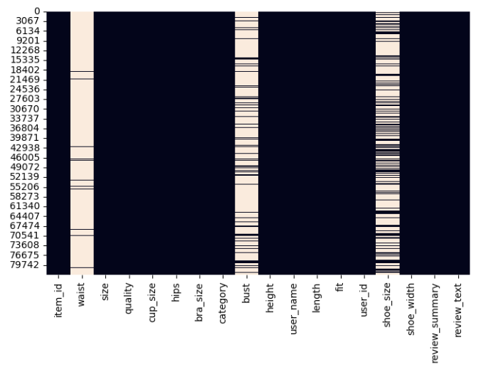
Output –

Slide 59
Project Flow
5.Find the outliers which are below and above 2.5 * IQR - Q1 and 2.5 * IQR + Q3.
Code – Q1=js.quantile(0.25)
Q3=js.quantile(0.75)
IQR =Q3-Q1
print("Lower:",2.5 * IQR - Q1)
print("High:",2.5 * IQR + Q3)
Solution – To find the outliers we find Q1 and Q3 through which we found the interquartile range and finally we get the outilers below and upper Q1 and Q3.
Inference – The Output represent the outliers below and above the 2.5*IQR-Q1 and 2.5*IQR+Q3.

Slide 60
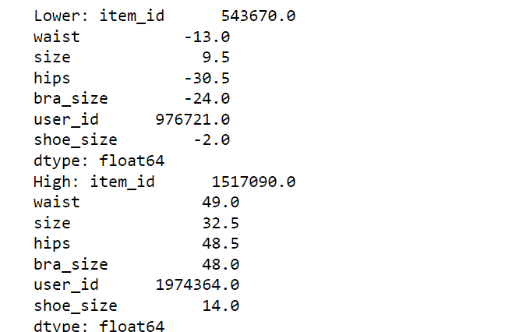
Output –

Slide 61
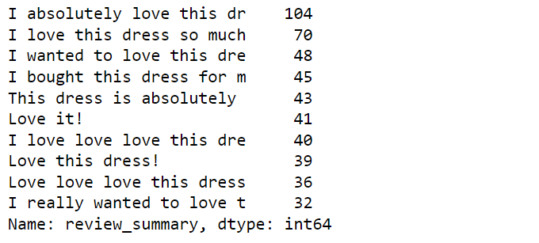
Project Flow
6.Check for the category dress review and visualize the top 10 reviews using any relevant plot. Identify the negative reviews if there are any.
Code – df_dress=js[js['category']=='dresses']['review_summary’]
df_dress.value_counts().head(10)
Solution – Firstly we have filtered the column category and found the value count for variable category == ‘dresses’.
Inference – The output shows the value count for ‘dresses‘ category.
Output –

Slide 62
Project Flow
7. Find out the average shoe size for the different fits of the customer. Visualize using any relevant plot. Explain that, Is there any significant different shoe sizes for different fits?
Code – sns.boxplot('shoe_size',data=js)
plt.show()
plt.figure(figsize=(10,7))
pd.pivot_table(data=js,index=['fit'],values=['shoe_size'],aggfunc=np.mean).plot(kind='bar’)
plt.xlabel('shoe_size', fontsize=18)
plt.show()
Solution – By using bar plot we can visualize the plot of average show size against fit to check is there any significant different shoe sizes for different fit.
Inference – The bar plot representing that all the fit having same shoe size.

Slide 63
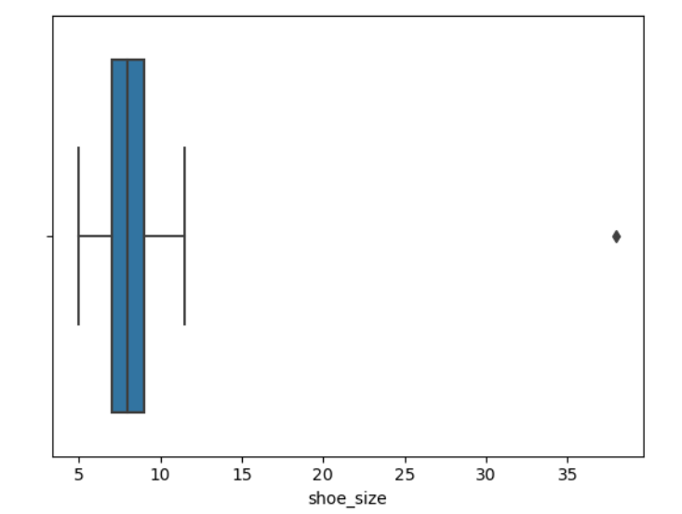
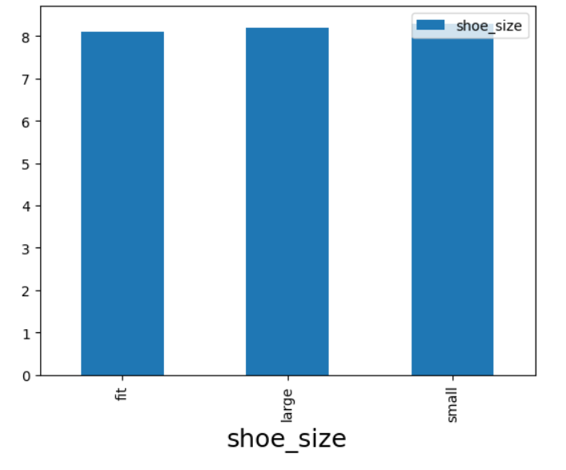
Output –

Slide 64
Project Flow
8.Identify the customer’s common shoe width and average size for those who purchased the maximum quality. Is the mode of shoe width affect the user review? Visualize using the appropriate plot.
Code – js['shoe_width'].value_counts()
js['shoe_width'].replace(np.nan,'average',inplace=True)
js.info()
js[['quality']] = js[['quality']].astype(float)
js['quality'].max()
js.info()
Solution – In this we replace the null value in variable ‘shoe_width’ with average and then chage the data type of column ‘quantity’ into float and find the max quantity.
Inference –The output represent the Changed data type and max quantity.

Slide 65
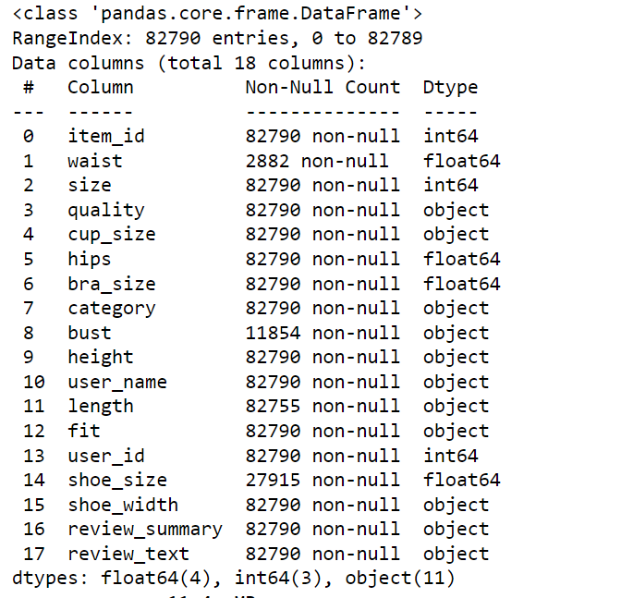
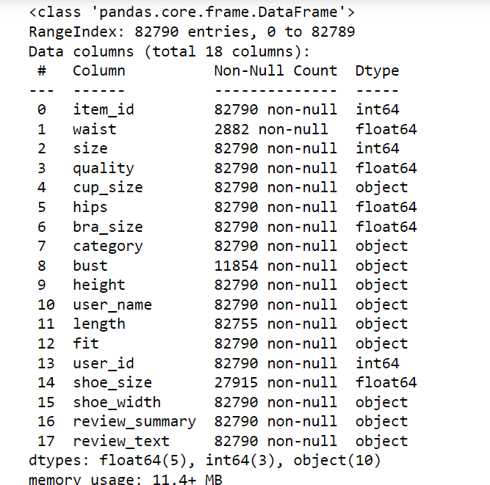
Output –
5.0
To Be Continued…….

Slide 66
Code – df=pd.DataFrame(js[(js['shoe_width']=='average')& (js['quality']==5.0)])
df.head()
df['size'].mean()
df['shoe_width'].mode()
pd.pivot_table(js, values='review_summary’, index=['shoe_width'],aggfunc='count').plot(kind='bar’)
plt.show()
Solution – Here we have created the dataframe Which satisfying the mentioned condition and then we find the mean ,mode and created a pivot table against review_summary and shoe_width.
Inference – for average shoe_width the count of review summary is more then 70000 where as for ‘narrow’ and ‘width’ shoe its very less number of reviews.

Slide 67
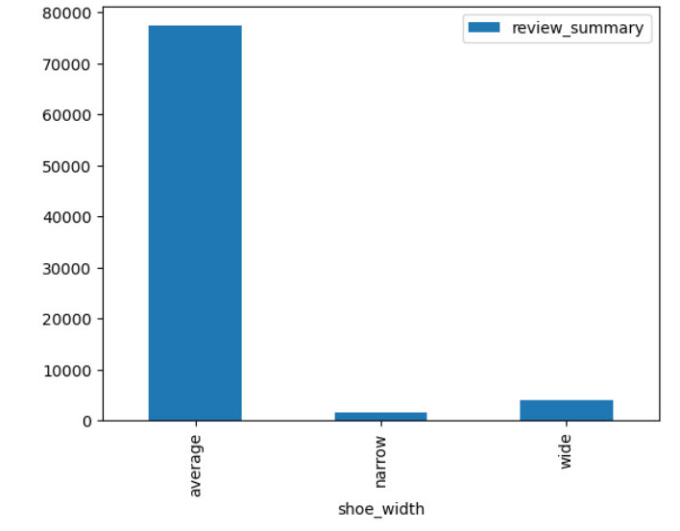
Output –
mean: 12.362646930779277
Mode: average

Slide 68
Project Flow
9.Extract the records belonging to the top 10 reviews, and then find the review summary for the different cup sizes. The basic analysis explains what you would try to infer. Try to use visualization
Code – js[['review_summary','cup_size’]] df=pd.DataFrame(js[['review_summary','cup_size']]).value_counts().reset_index().rename(columns={0:'count_n’})
Df
pd.pivot_table(df,index=['cup_size'],values=['count_n'],aggfunc='count').sort_values(by='count_n',ascending=False).plot(kind='bar')
plt.show()
Solution – Firstly we have created the dataframe containing new column ‘count_n’ and then then we plot the bar graph between count_n and cup_size.
Inference – The graph represent the count for each cup size . The graph is left shewed. The cup_size ‘c’ having highest count number.

Slide 69
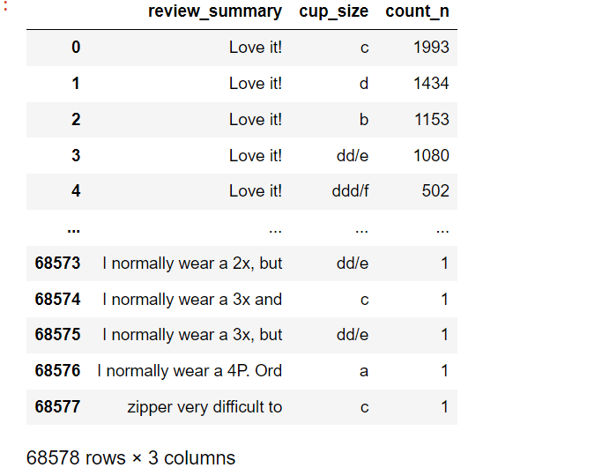
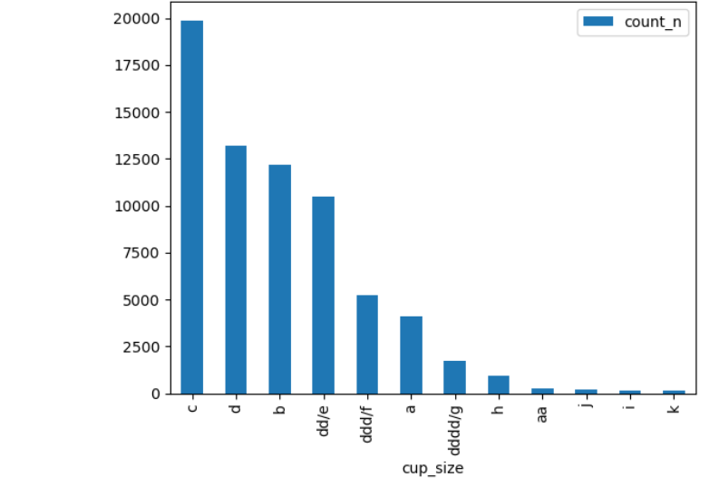
Output –

Slide 70
Project Flow
10.Identify the most common review that we got from the customer whose hips size is greater than 35. Find out what kind of inference you can make.
Code – hp=pd.DataFrame(js[(js.hips> 35)])
hp.head()
hp[['review_summary']].value_counts().reset_index().head(10).rename(columns={0:'common_review'})
Solution – Firstly we have created the dataFrame for hips greater then 35 and then createda new column ‘common_review’ which contain the total counts for each category in review summary.
Inference – The output shows value count for each category of reviews the highest reviews are ‘Love it!’.

Slide 71
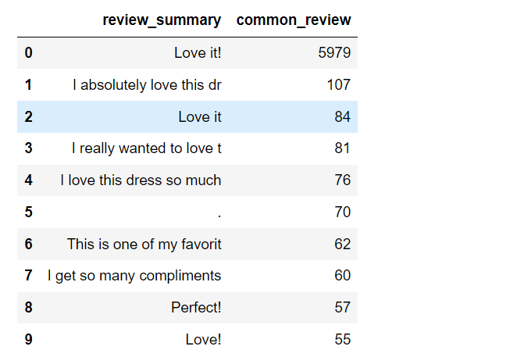
Output –

Slide 72
Project Flow
11.What is the relationship between height and waist? Describe what kind of relationship it has.
Code – pd.pivot_table(js,index=['waist'],values=['height'],aggfunc=('count')).plot(kind='line’)
plt.figure(figsize=(15,10))
plt.show()
Solution – To show relationship between ‘height’ and ‘waist’ we used line plot.
Inference – From the graph we can conclude that there are most number of people with given height having waist 30.

Slide 73
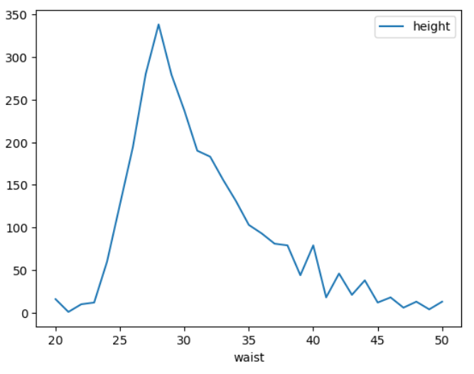
Output –

Slide 74
Project Flow
12.Plot the pair plot for the numerical plot. Explain according to your problem statement how the pair plot would help you.
Code – df_2=js.select_dtypes(include=np.number)
df_2.head()
sns.pairplot(df_2,diag_kind='kde')
Solution – Here we have created dataFrame having only numerical columns then we plot the pair plot to show the relation between all variables.
Inference – The output showing the relation between all the variables.

Slide 75
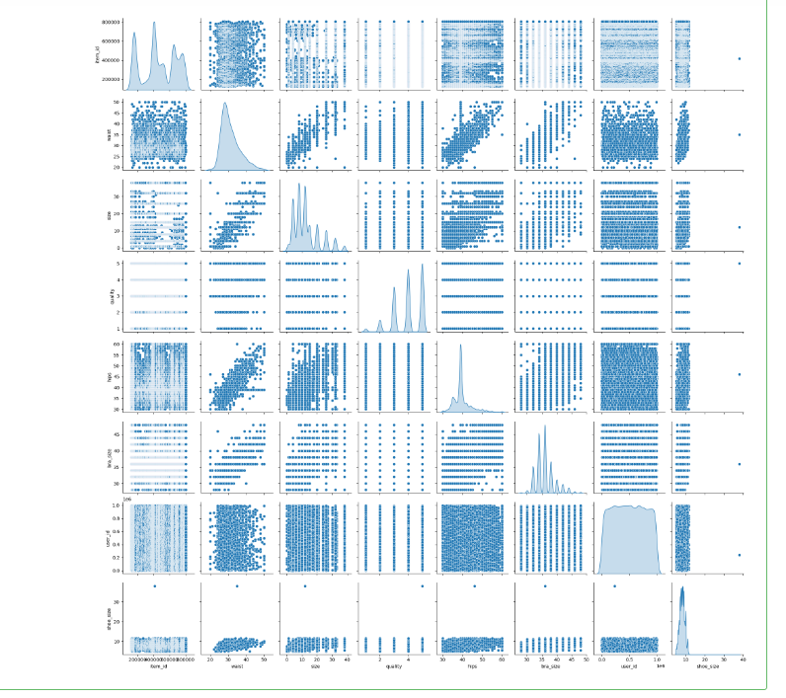
Output –

Slide 76
Project Flow (Statistical Analysis)
1.Test the claim that the category feature and review summary have any relationship among them. The level of significance is 5%.
Code – table= pd.crosstab(js['review_summary'],js['category’])
table.head()
chi2_val = round(stats.chi2.isf(q = 0.05, df = 5), 4)
print('Critical value for chi-square test:', chi2_val)
test_stat, p, dof, expected_value =chi2_contingency(observed=table,correction=False)
print("Test statistic:", test_stat)
print("p-value:", p)
print("Degrees of freedom:", dof)
print("Expected values:", expected_value)
Solution – Here we have created the crosstable for variables ‘review summary’ and ‘category’. Then by using chisquare we find z critical value and at last by using chi2_contingency we find the Test statstics , DOF , p-value and Expected value to show the dependency of variables.
Inference – As the test statistic is greater then critical value and p- value is less then 0.05 we will reject null hypothesis and can conclude that two variables are dependent.

Slide 77
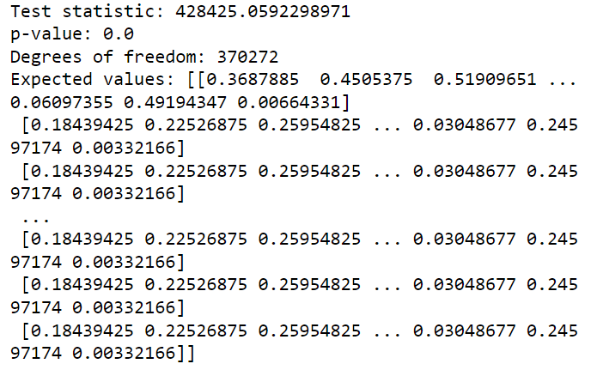
Output –

Slide 78
Project Flow
Does the quality significantly differ for any one shoe width? Test the test with 96%confidence intervals. Check the normality of the data before the above test. Alpha = .05
𝐻0 : The quality differ of all shoe_width are the same.
𝐻1 : The quality differ of all shoe_width is not same
Code – from scipy.stats import Shapiro
stat,p_value = stats.shapiro(js['quality’])
print('p-value:', p_value)
js['shoe_width'].unique()
gr_A = js[js['shoe_width'] == 'average']['quality’]
gr_B = js[js['shoe_width'] == 'wide']['quality’]
gr_C = js[js['shoe_width'] == 'narrow']['quality’]
t = js['shoe_width'].nunique()
print('t:', t)
N = js['shoe_width'].value_counts().sum()
print('N:', N)
f_test, p_val = stats.f_oneway(gr_A,gr_B,gr_C)
print('Test statistic:', f_test)
print('p-value:', p_val)

Slide 79


Inference –
As P_val < alpha so we reject null hypothesis hence quality differ for one shoe_width significantly.
Output – P-value: 0.0

Slide 80
Project Flow
4.Check if the shoe width feature affects the review summary with a 99% confidence interval.
Code – table1= pd.crosstab(js['review_summary'],js['shoe_width’])
table1
chi2_val = round(stats.chi2.isf(q = 0.05, df = 2), 4)
print('Critical value for chi-square test:', chi2_val)
test_stat, p, dof, expected_value =chi2_contingency(observed=table1,correction=False)
print("Test statistic:", test_stat)
print("p-value:", p)
print("Degrees of freedom:", dof)
print("Expected values:", expected_value)
Solution – To check the indepandenc od columns we used chi2_contingency() method.
Inference – As P-Val is < alpha so we reject null hypothesis and shoe_width and reviw_summary are dependent variable

Slide 81
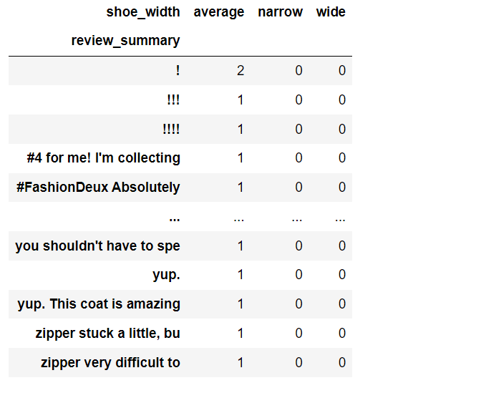
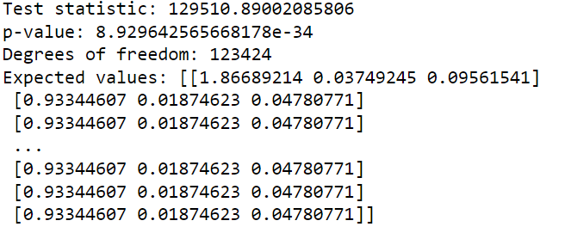
Output –

Slide 82
Project Flow
5.Check if the length feature affects the review summary with a 95% confidence interval.
Code – test_stat, p, dof, expected_value =chi2_contingency(observed=table2,correction=False)
print("Test statistic:", test_stat)
print("p-value:", p)
print("Degrees of freedom:", dof)
print("Expected values:", expected_value)
Solution – To check the dependency of variables ‘ length ‘ and ‘review summary’ we used chi2_contingency method.
Inference – P_val < alpha so we reject null hypothesis hence length and review summary are dependent variables.

Slide 83
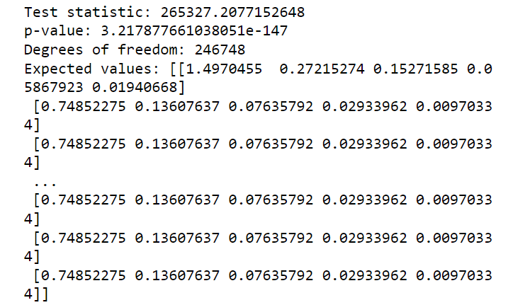
Output –

Slide 84
Project Flow
6.Does the average quality significantly differ for the different fits? Kindly test the relevant hypothesis test by having 0.05 alpha. Check the normality of the data before the above test. Alpha = .05
Code – js['fit'].unique()
gr_a = js[js['fit'] == 'small']['quality’]
gr_b = js[js['fit'] == 'fit']['quality’]
gr_c = js[js['fit'] == 'large']['quality’]
t = js['fit'].nunique()
print('t:', t)
N = js['fit'].value_counts().sum()
print('N:', N)
f = round(stats.f.isf(q = 0.05, dfn = 2, dfd =82787 ), 4)
print('Critical value for F-test:', f)
f_test, p_val = stats.f_oneway(gr_a,gr_b,gr_c)
print('Test statistic:', f_test)

Slide 85

Solution – To check the average quality differ for the different fits we used ‘one-way ANOVA test.
Inference – As t_stat > critical value so we fail to reject null hypothesis hence average quality for different is same.
Output –

Slide 86
Conclusion: -
So finally, there is a lot more in EDA than We just covered here. To sum up the EDA, we can say that it is really helpful to know data before you use it to train your model with it. For analysis part we use different visualization technique. We perform various data cleaning techniques and tried to gain some insight knowledge from the data.
We applied various statistical test which provides a mechanism for making quantitative decisions about a process or processes. The intent is to determine whether there is enough evidence to "reject" a conjecture or hypothesis about the process.

Slide 87


